Slide 1
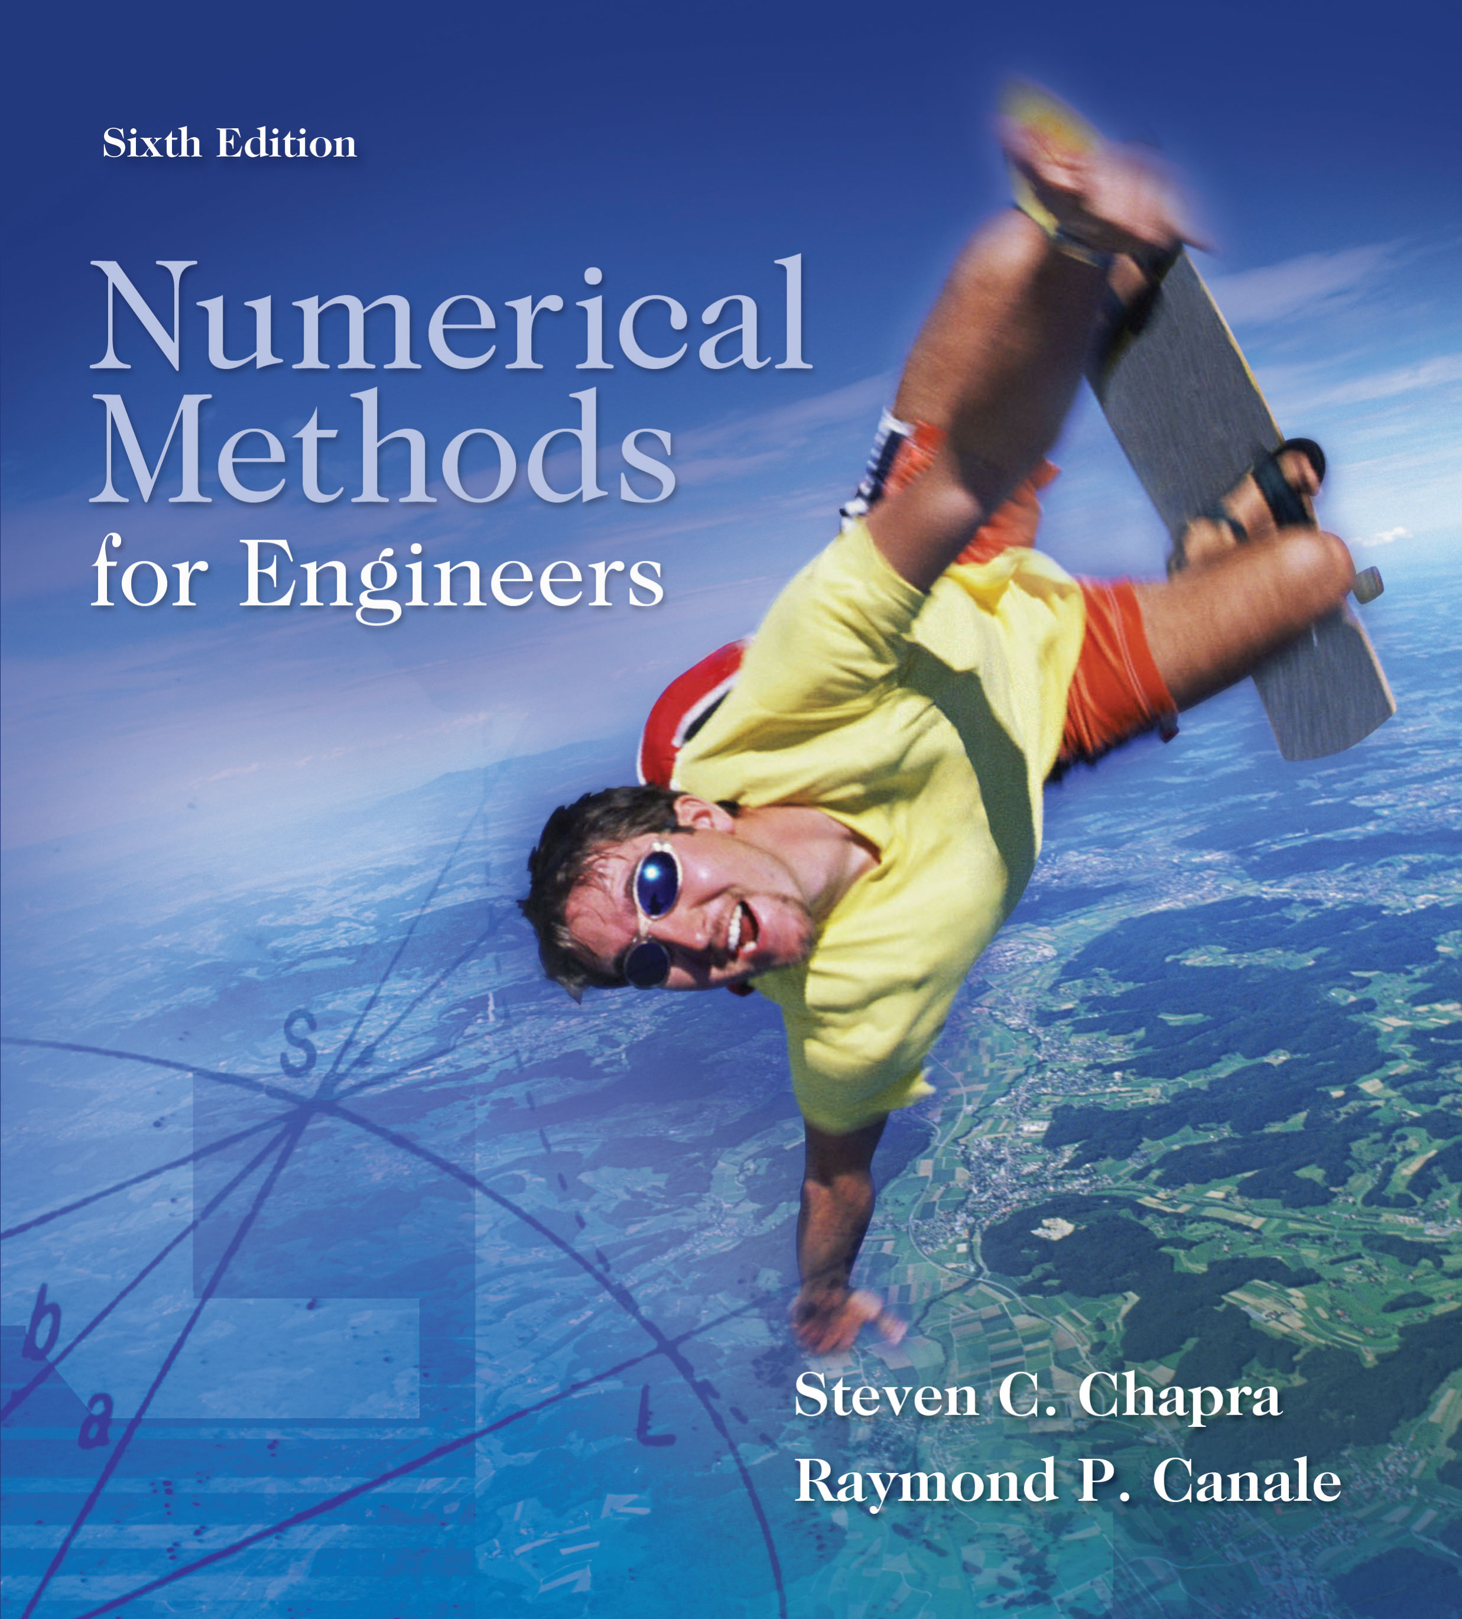
Part 7 - Chapter 25

Slide 2
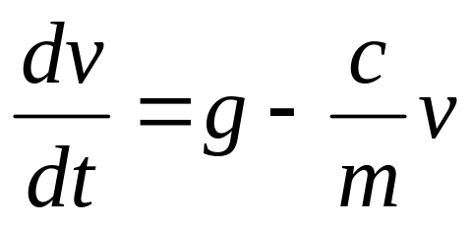
Part 7
Ordinary Differential Equations
Equations which are composed of an unknown function and its derivatives are called differential equations.
Differential equations play a fundamental role in engineering because many physical phenomena are best formulated mathematically in terms of their rate of change.
v- dependent variable
t- independent variable

Slide 3
When a function involves one dependent variable, the equation is called an ordinary differential equation (or ODE). A partial differential equation (or PDE) involves two or more independent variables.
Differential equations are also classified as to their order.
  A first order equation includes a first derivative as its highest derivative.
  A second order equation includes a second derivative.
Higher order equations can be reduced to a system of first order equations, by redefining a variable.

Slide 4
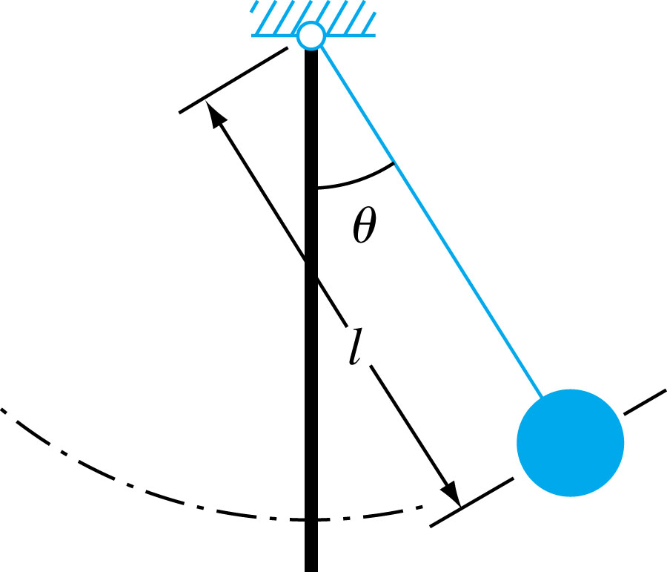
ODEs and Engineering Practice
Figure PT7.1

Slide 5
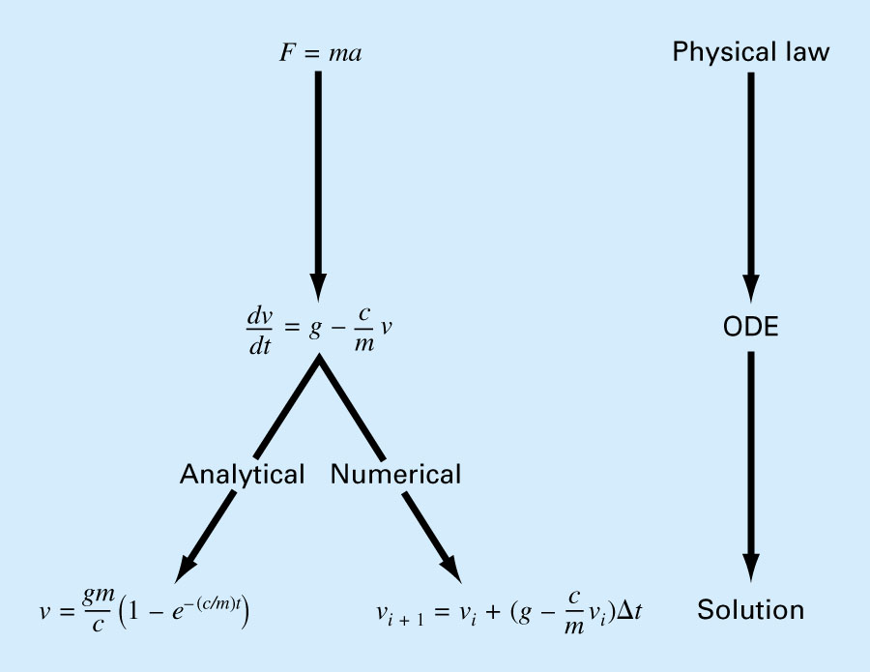
Figure PT7.2

Slide 6
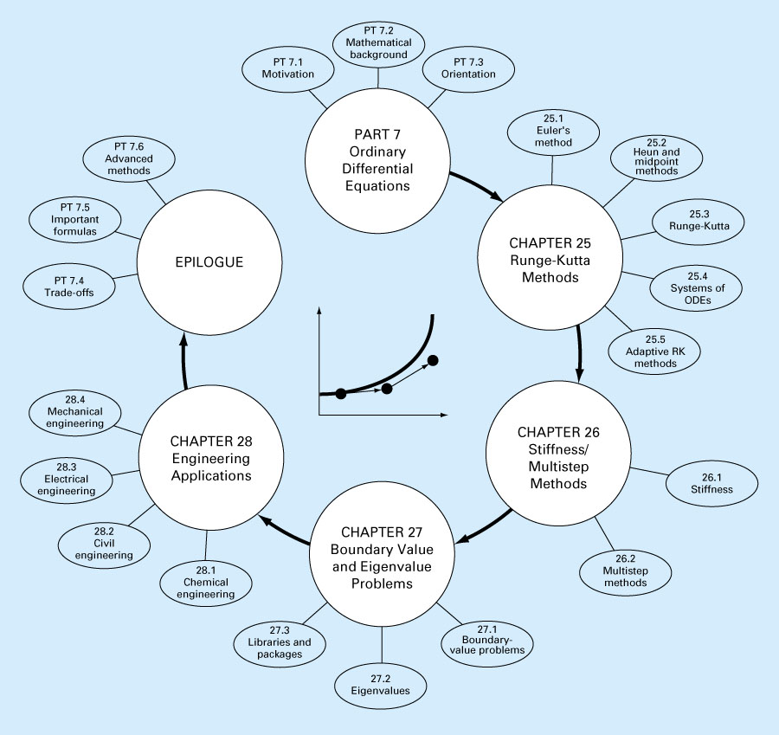
Figure PT7.5

Slide 7
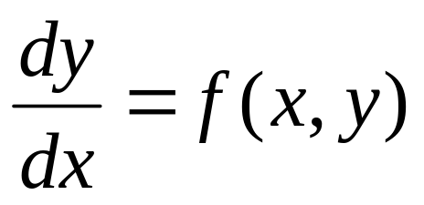
Runga-Kutta Methods
Chapter 25
This chapter is devoted to solving ordinary differential equations of the form
Euler’s Method

Slide 8
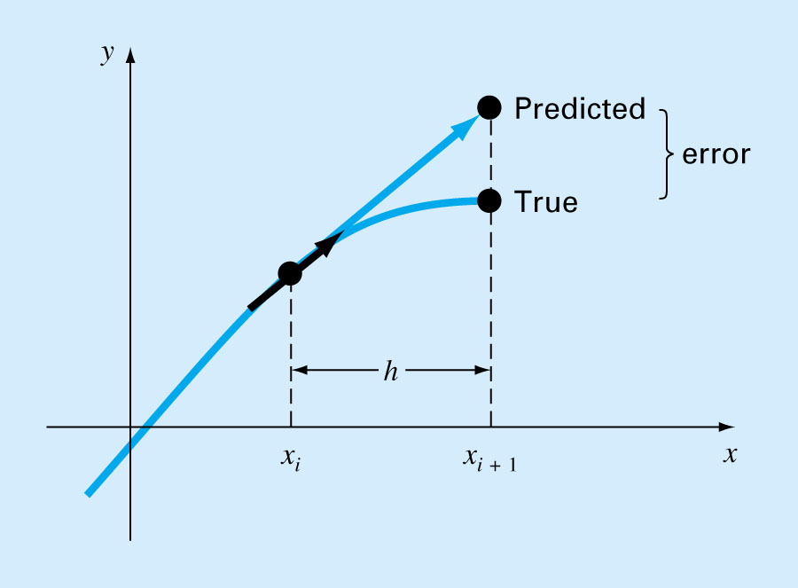
Figure 25.2

Slide 9
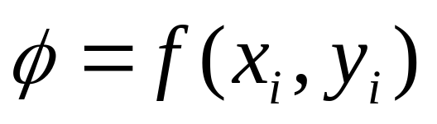
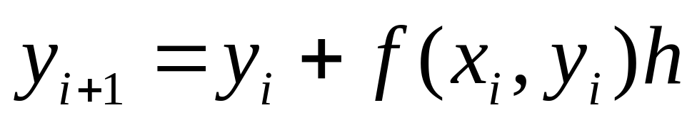
The first derivative provides a direct estimate of the slope at x_{i}
where f(x_{i},y_{i}) is the differential equation evaluated at x_{i} and y_{i}. This estimate can be substituted into the equation:
A new value of y is predicted using the slope to extrapolate linearly over the step size h.

Slide 10
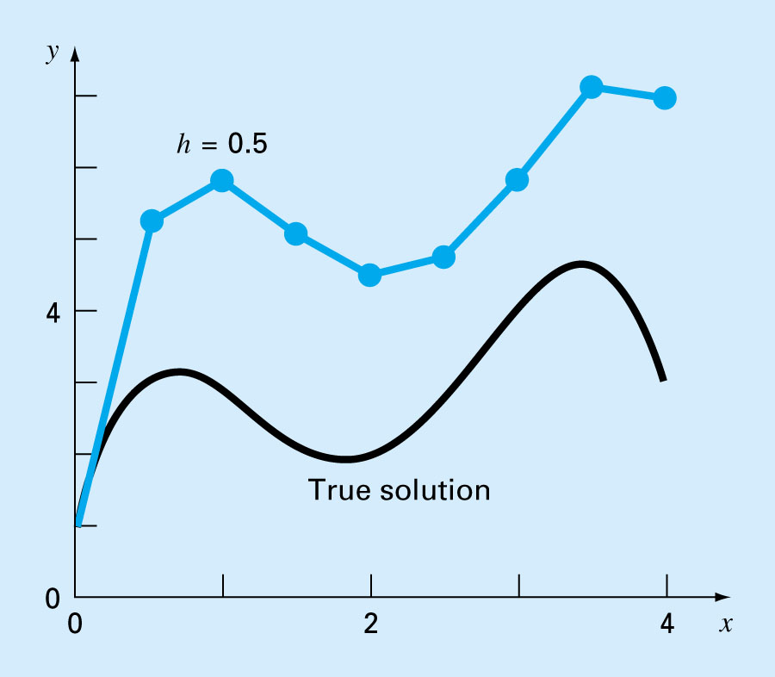
Figure 25.3

Slide 11
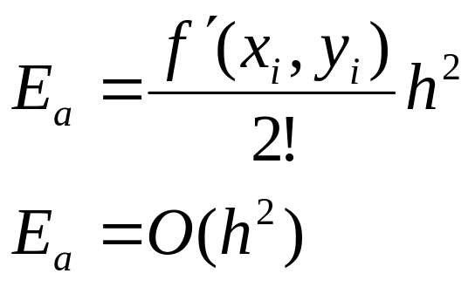
Error Analysis for Euler’s Method/
Numerical solutions of ODEs involves two types of error:
  Truncation error
    Local truncation error
    Propagated truncation error
  The sum of the two is the total or global truncation error
  Round-off errors

Slide 12
The Taylor series provides a means of quantifying the error in Euler’s method. However;
  The Taylor series provides only an estimate of the local truncation error-that is, the error created during a single step of the method.
  In actual problems, the functions are more complicated than simple polynomials. Consequently, the derivatives needed to evaluate the Taylor series expansion would not always be easy to obtain.
In conclusion,
  the error can be reduced by reducing the step size
  If the solution to the differential equation is linear, the method will provide error free predictions as for a straight line the 2nd derivative would be zero.

Slide 13
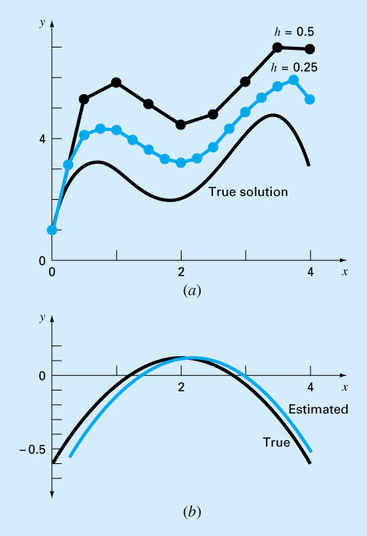
Figure 25.4

Slide 14
Improvements of Euler’s method
A fundamental source of error in Euler’s method is that the derivative at the beginning of the interval is assumed to apply across the entire interval.
Two simple modifications are available to circumvent this shortcoming:
  Heun’s Method
  The Midpoint (or Improved Polygon) Method

Slide 15
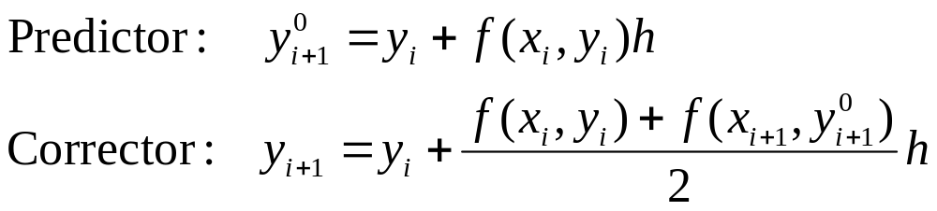
Heun’s Method/
One method to improve the estimate of the slope involves the determination of two derivatives for the interval:
  At the initial point
  At the end point
The two derivatives are then averaged to obtain an improved estimate of the slope for the entire interval.

Slide 16
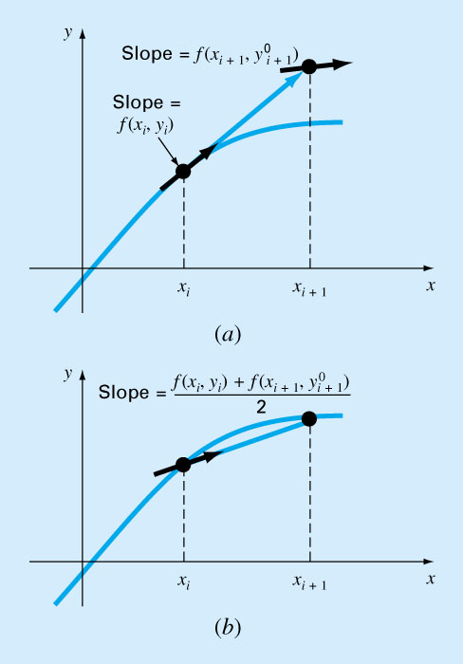
Figure 25.9

Slide 17
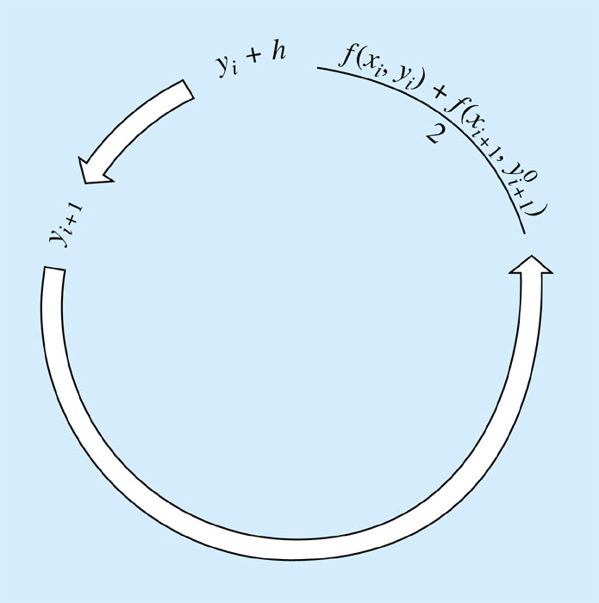
Figure 25.10

Slide 18
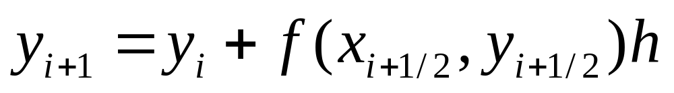
The Midpoint (or Improved Polygon) Method/
Uses Euler’s method t predict a value of y at the midpoint of the interval:

Slide 19
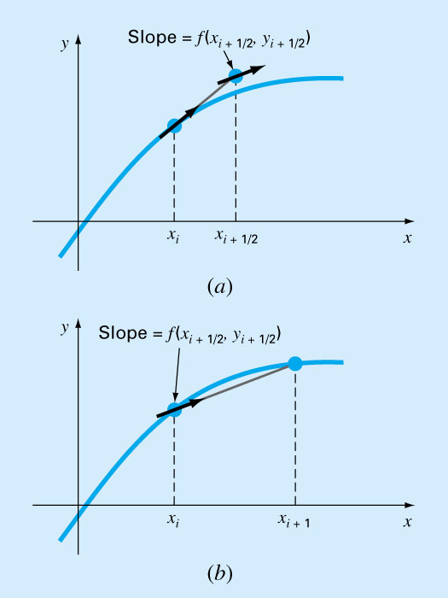
Figure 25.12

Slide 20
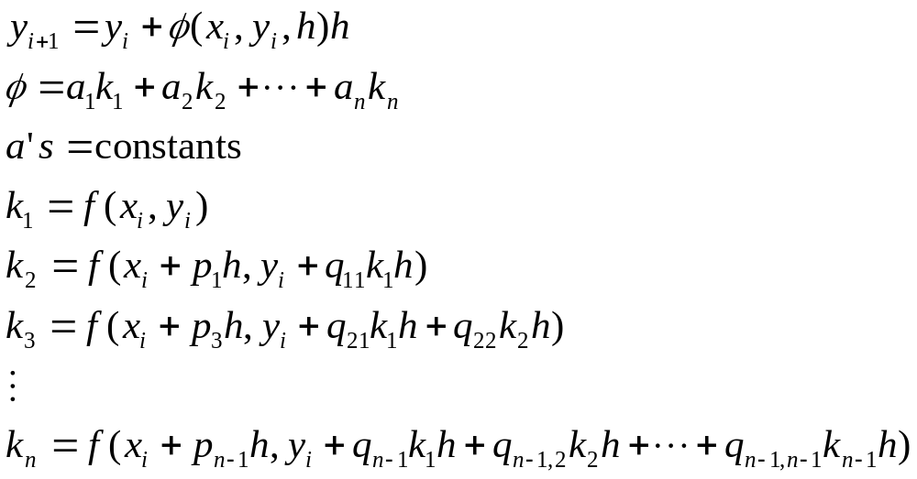
Runge-Kutta Methods (RK)
Runge-Kutta methods achieve the accuracy of a Taylor series approach without requiring the calculation of higher derivatives.
Increment function
p’s and q’s are constants

Slide 21
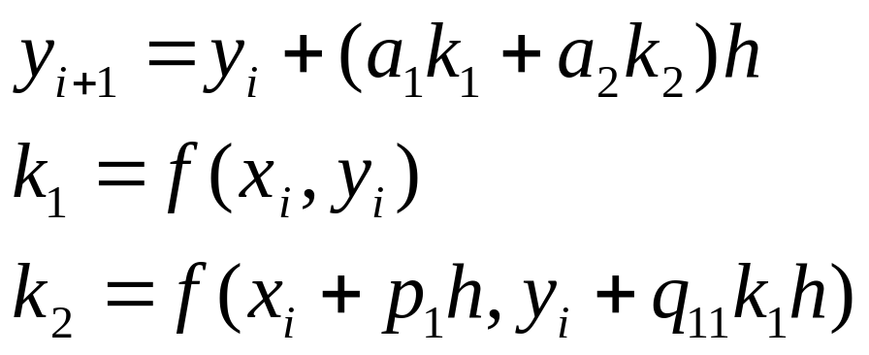
k’s are recurrence functions. Because each k is a functional evaluation, this recurrence makes RK methods efficient for computer calculations.
Various types of RK methods can be devised by employing different number of terms in the increment function as specified by n.
First order RK method with n=1 is in fact Euler’s method.
Once n is chosen, values of a’s, p’s, and q’s are evaluated by setting general equation equal to terms in a Taylor series expansion.

Slide 22
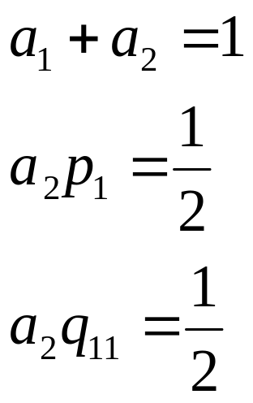
Values of a₁, a₂, p₁, and q₁₁ are evaluated by setting the second order equation to Taylor series expansion to the second order term. Three equations to evaluate four unknowns constants are derived.
A value is assumed for one of the unknowns to solve for the other three.

Slide 23
Because we can choose an infinite number of values for a₂, there are an infinite number of second-order RK methods.
Every version would yield exactly the same results if the solution to ODE were quadratic, linear, or a constant.
However, they yield different results if the solution is more complicated (typically the case).
Three of the most commonly used methods are:
  Huen Method with a Single Corrector (a₂=1/2)
  The Midpoint Method (a₂=1)
  Raltson’s Method (a₂=2/3)

Slide 24
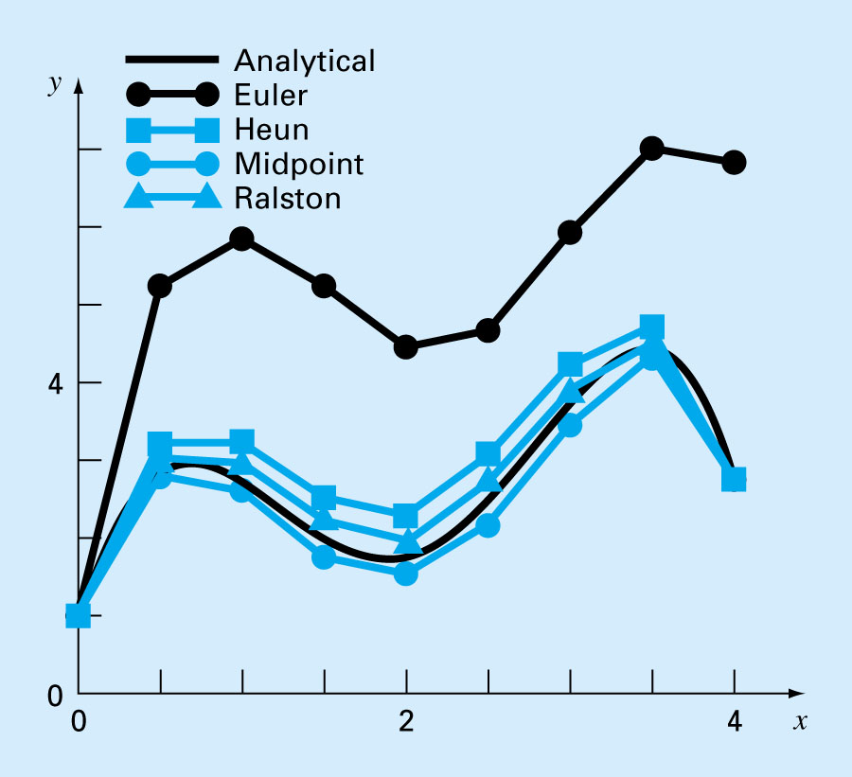
Figure 25.14

Slide 25
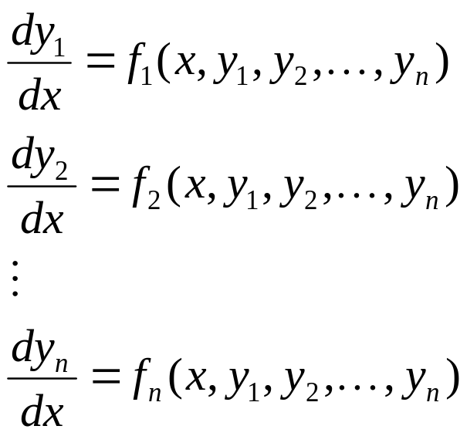
Systems of Equations
Many practical problems in engineering and science require the solution of a system of simultaneous ordinary differential equations rather than a single equation:
Solution requires that n initial conditions be known at the starting value of x.

Slide 26
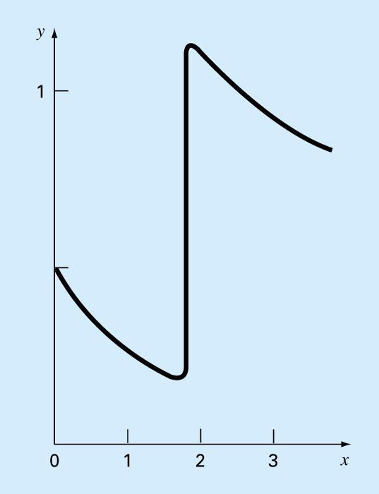
Adaptive Runge-Kutta Methods
Figure 25.20
For an ODE with an abrupt changing solution, a constant step size can represent a serious limitation.

Slide 27
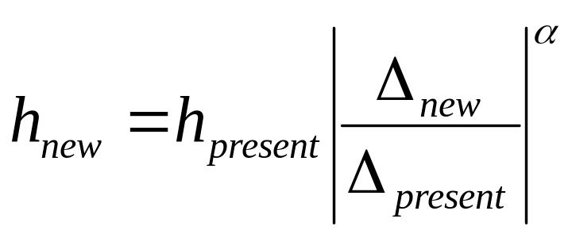
Step-Size Control/
The strategy is to increase the step size if the error is too small and decrease it if the error is too large. Press et al. (1992) have suggested the following criterion to accomplish this:
Δ_{present}= computed present accuracy
Δ_{new}= desired accuracy
α= a constant power that is equal to 0.2 when step size increased and 0.25 when step size is decreased

Slide 28
Implementation of adaptive methods requires an estimate of the local truncation error at each step.
The error estimate can then serve as a basis for either lengthening or decreasing step size.

